Slide 1

GParticles
A flexible GPU-based particle library
Tiago Dinis and António Ramires
University of Minho
EPCGI 2016

Slide 2
What is a particle?
Notes:
Since we’ll be talking about particle systems...

Slide 3
An entity with data,
driven by behaviour rules
Notes:
Applying the rules on particle data gets us a particle simulation
PS are used to model many effects otherwise hard to accomplish

Slide 4

Notes:
Fuzzy Volumetric effects

Slide 5
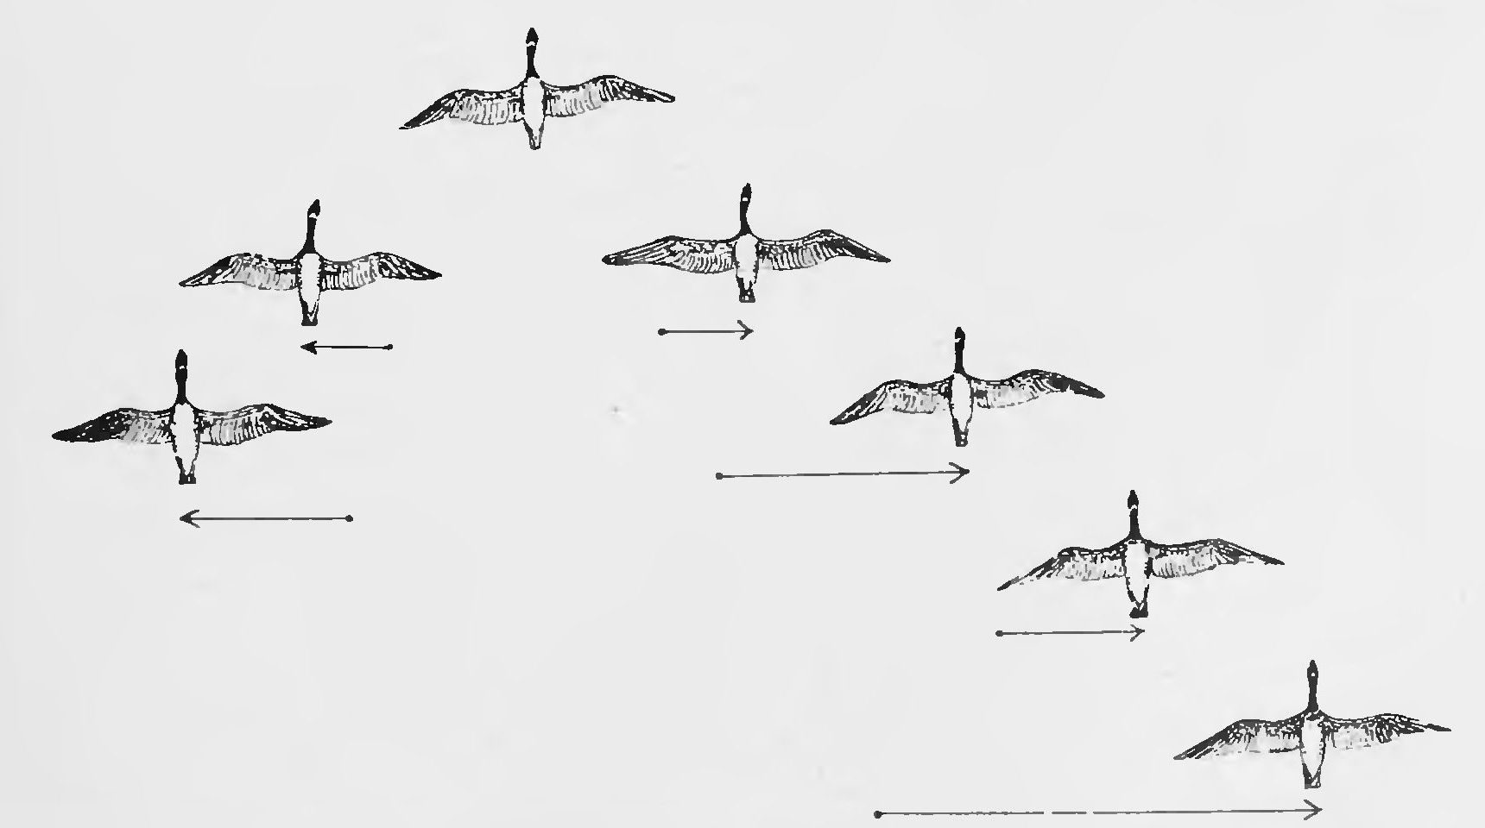
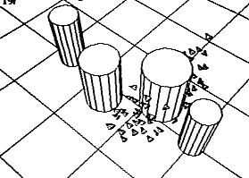
Notes:
Natural phenomena
Systems with complex behaior (such as flocking of birds)

Slide 6

Notes:
Explosions

Slide 7
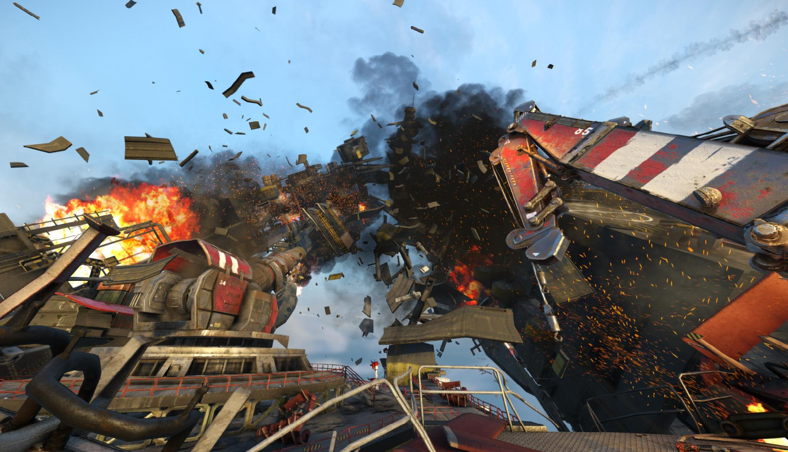
Notes:
They can be combined to greatly increase immersion

Slide 8
What has been done before?
Notes:
We started our work by researching what has been done before
Alot. So we had to focus and ...

Slide 9
Real-time vs Batching
Notes:
Preferred interactivity

Slide 10
Real-time vs Batching
Stateless vs Stateful
Notes:
Wanted interactions with environment and different simulation paths for particles
Stateful systems preserve state throughout simulation iterations

Slide 11
Real-time vs Batching
Stateless vs Stateful
CPU vs GPU
Notes:
Graphics people
More particles

Slide 12
Fragment shaders, FBOs
and textures
Notes:
Applying this huge filter we found out the first big rise

Slide 13
Fragment shaders, FBOs
and floating-point textures
Notes:
Started being taken more seriously

Slide 14


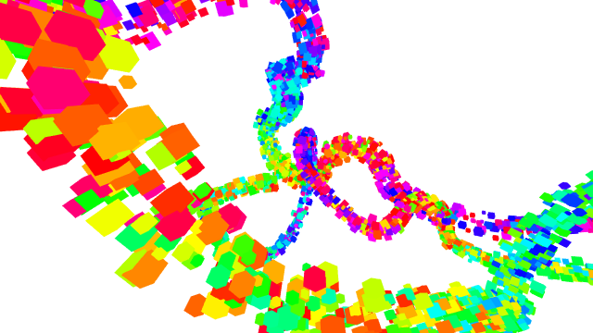

Kvant/Spray v2
for
ParticlesGPU
for

Slide 15
Compute shaders
Notes:
Single stage programs
Massive improvement on previous ways

Slide 16
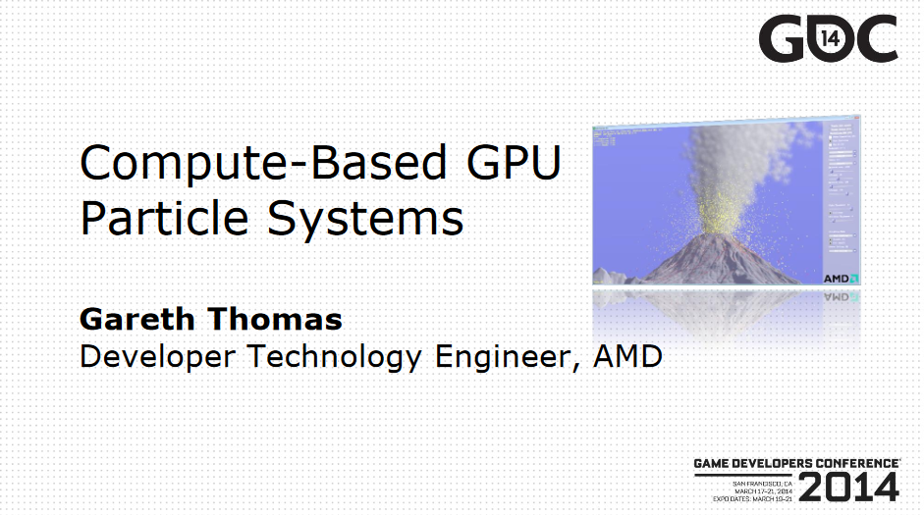
Notes:
Gave overview of a compute-based ps architecture

Slide 17
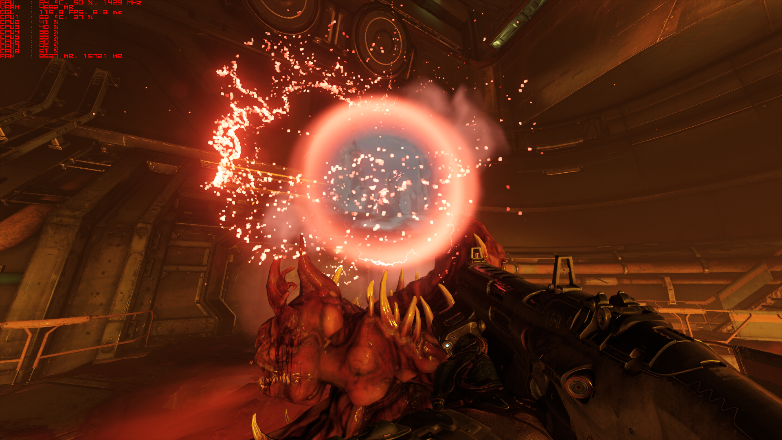
Notes:
Doom remake
First videogame

Slide 18
However
Notes:
However, from ou research
Have 2 of the following 3 issues

Slide 19
Attached to big frameworks
Notes:
Forcing users to use and learn specific development environment

Slide 20
Attached to big frameworks
Limited control
Notes:
Usually through a predefined set of options

Slide 21
Attached to big frameworks
Limited control
Poor documentation
Notes:
Poor to no documentation whatsoever

Slide 22
Goals
Notes:
Taking this into account

Slide 23
GPU-centric library
Notes:
More particles;
Explore work-arounds for GPU ps design

Slide 24
GPU-centric library
Extensible architecture
Notes:
That allowed full control over particle simulation
At different scales

Slide 25
GPU-centric library
Extensible architecture
KISS
(keep it simple, stupid!)
Notes:
Keep everything as simple as
Code, usability and integrations with user apps

Slide 26
GParticles
in C++ and OpenGL
Notes:
And so,
GParticles came to be
In c++ and OpenGL

Slide 27
GParticles Architecture:
Data
Notes:
Let’s take a look at its architecture

Slide 28
Buffers
ps_positions =
ps_lifetimes =
.
.
.
(1, -2, 3)
(0, 5, 5)
(0, 0, 0)
. . .
3.2
1.9
0
. . .
Notes:
Mainly used to represent particle properties

Slide 29
Atomics
aliveParticles =
updatedParticles =
11345
820
Notes:
… keep track of important numbers acessed concurrently
Limited but important

Slide 30
Uniforms
gravity =
spacebarPressed =
(0, -9.8, 0)
1
Notes:
Refer to global parameters
Immutable during shader execution

Slide 31
GParticles Architecture:
Stage
Notes:
A sub process of a particle system simulation

Slide 32
Emission
Notes:
3 stage convetion
Creation and initialization
Updates with behavior rules
Dictates how particle appears on screen

Slide 33
Emission
Update
Notes:
3 stage convetion
Creation and initialization
Updates with behavior rules
Dictates how particle appears on screen

Slide 34

Emission
Update
Render
Notes:
3 stage convetion
Creation and initialization
Updates with behavior rules
Dictates how particle appears on screen

Slide 35
Properties
Handle
Max
Particles
Stage
Iteration
Step
Last
Step
...

Slide 36
Properties
Handle
Max
Particles
Stage
Iteration
Step
Last
Step
...
Tag
Tag
Tag
Tag
Tags
Notes:
Can be labeled with

Slide 37
Properties
Headers
Handle
Max
Particles
Uniforms
Stage
Iteration
Step
Atomics
Last
Step
Buffers
...
Tag
Tag
Tag
Tag
Tags
Notes:
References data required resources

Slide 38
Stubs
Start
Stub
End
Stub
Properties
Headers
Handle
Max
Particles
Uniforms
Stage
Iteration
Step
Atomics
Last
Step
Buffers
...
Tag
Tag
Tag
Tag
Tags
Notes:
Has slots for stubs, C++ functions that can be executed before or after
Deep level of effect customization

Slide 39
GParticles Architecture:
Particle System

Slide 40
Stages
Particle System
Stage
Notes:
Aggregation of

Slide 41
Stages
Properties
Name
Lifetime
Particle System
Model
Matrix
LifeStart
Stage
Looping
...
Notes:
Global properties

Slide 42
GParticles Architecture:
High-level components
Notes:
Facade for the users

Slide 43
GPSYSTEMS
Uniforms
GPDATA
Atomics
Buffers
Particle System
Time
Viewport

Slide 44
Iteration example

Slide 45
Particle System
Stage
Particle System
Stub
Particle System
Stage
. . .
Notes:
Goes through the particle systems
Goes through stages

Slide 46
GParticles extensibility:
Notes:
Now lets talk about

Slide 47
XML project file
Shader files
Application API
Notes:
First level of … alter configurations, parameters and use prefab tag to easily exchange between sets of data and behaviors
API mos deep level. Directly tinker with data resources, stage flow execution ...

Slide 48
Shader files
Notes:
Level GParticles expects users to play around with the most.
Effective customization with little effort
Has three types of files

Slide 49
Template

Slide 50
Template
Module
m1()
m2()
m3()
m4()

Slide 51
Template
Module
Custom Logic
m1()
cl()
m2()
m3()
m4()

Slide 52
updateMain.temp
void main() {
}
Notes:
Outer shell of the shader
Bolierplate functionality for update stage

Slide 53
updateMain.temp
void main() {
// if particle is not alive
if (@lifetimes[gid] <= 0) return;
// age particle
@lifetimes[gid] -= @deltaTime;
}
Notes:
Is particle alive? Age it. Else? exit

Slide 54
updateMain.temp
void main() {
// if particle is not alive
if (@lifetimes[gid] <= 0) return;
// age particle
@lifetimes[gid] -= @deltaTime;
// if particle just died, decrement number of
// alive particles and exit
if (@lifetimes[gid] <= 0) {
atomicCounterDecrement(@aliveParticles);
return;
}
}

Slide 55
updateMain.temp
customUpdate.glsl
void main() {
// if particle is not alive
if (@lifetimes[gid] <= 0) return;
// age particle
@lifetimes[gid] -= @deltaTime;
// if particle just died, decrement number of
// alive particles and exit
if (@lifetimes[gid] <= 0) {
atomicCounterDecrement(@aliveParticles);
return;
}
// custom logic function
update();
}
void update() {
// TODO
}
Notes:
Call custom logic function

Slide 56
A simple project extension

Slide 57
default.xml
<project>
<prefab path=".../defaultResources.xml" />
<psystem name="mypsystem">
<properties>
<position x=0 y=0 z=-5 />
</properties>
<stages>
<prefab path=".../defaultEmission.xml" />
<prefab path=".../defaultUpdate.xml" />
<prefab path=".../pointRender.xml" />
</stages>
</psystem>
</project>
Notes:
Default sphere particle system file
We want to create a system resembling a fountain with an invisible floor

Slide 58
default.xml
<prefab path=".../defaultEmission.xml" />
<prefab path=".../defaultUpdate.xml" />
<prefab path=".../pointRender.xml" />
Notes:
Switch rendering prefab fom points to billboards

Slide 59
default.xml
<prefab path=".../defaultEmission.xml" >
<inject slot="customFunction">
<file name="custom"
path=".../customEmission.glsl" />
</inject>
</prefab>
<prefab path=".../defaultUpdate.xml" />
<prefab path=".../pointRender.xml" />

Slide 60
default.xml
void emission()
{
@lifetimes[gid] = 5;
@positions[gid] = spherePositionGenerator(0.5, true);
...
}

Slide 61
default.xml
void emission()
{
@lifetimes[gid] = 5;
//@positions[gid] = spherePositionGenerator(0.5, true);
@positions[gid] = emitFromCone(1.5, 3, false, true);
...
}

Slide 62
default.xml
<prefab path=".../defaultEmission.xml" >
<inject slot="customFunction">
<file name="custom"
path=".../customEmission.glsl" />
</inject>
</prefab>
<prefab path=".../defaultUpdate.xml" />
<prefab path=".../pointRender.xml" />
Notes:
Going back to the xml file, lets change the update stage

Slide 63
default.xml
<prefab path=".../defaultUpdate.xml" />
Notes:
Going back to the xml file, lets change the update stage

Slide 64
default.xml
<stage>
<tag name="update"/>
<file path=".../customMain.glsl" />
</stage>
Notes:
Going back to the

Slide 65
default.xml
void update()
{
// update position
@positions[gid].xyz +=
@velocities[gid].xyz * @deltaTime;
}

Slide 66
default.xml
void update()
{
// update position
@positions[gid].xyz +=
@velocities[gid].xyz * @deltaTime;
// apply "gravity"
@velocities[gid].y -= 1 * @deltaTime;
}

Slide 67
default.xml
void update()
{
// update position
@positions[gid].xyz +=
@velocities[gid].xyz * @deltaTime;
// apply "gravity"
@velocities[gid].y -= 1 * @deltaTime;
// bounce from plane y = -4
if (@positions[gid].y < -4)
@velocities[gid].y *= -0.1;
}

Slide 69
Performance
(NVIDIA Geforce 630M 2GB)
Notes:
Just an ideia of GParticles overload. The results are encouraging, considering there no otimization is done.

Slide 70
POINTS | 100 | 10000 | 1M
Default | 158.84 fps | 157.72 fps | 111.51 fps
Fountain | 159.89 fps | 158.84 fps | 85.41 fps
Notes:
Rows: ps
Columns: number of particles
Fountain has a more complex update stage

Slide 71
BILLBOARDS | 100 | 10000 | 1M
Default | 163.19 fps | 162.28 fps | 62.66 fps
Fountain | 160.30 fps | 153.92 fps | 59.67 fps
Notes:
Still 60 fps with every billboard generated individually in geometry shader

Slide 72
CUBES | 100 | 10000 | 1M
OpenGL test | 250.96 fps | 247.24 fps | 10.44 fps
Fountain | 158.37 fps | 149.25 fps | 3.4 fps
Notes:
OpenGL test is instanced rendering of cubes.
The overhead of emission and update stages seems an acceptable cost

Slide 75
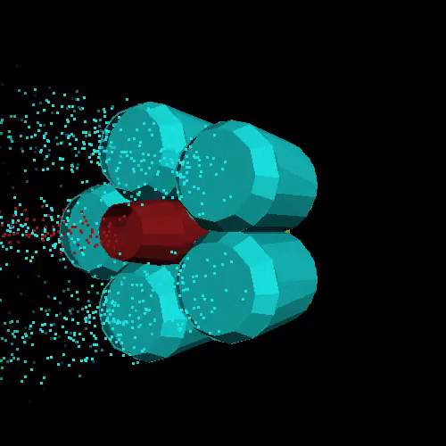

Slide 76
What next?
Notes:
Our initial goals were achieved but the work is never done

Slide 77
In-depth performance study
Notes:
Explore better distribution of workload and shared memory

Slide 78
Drag and Drop editor
Notes:
Better than using XML directly

Slide 79
GParticles
A flexible GPU-based particle library
Tiago Dinis and António Ramires
University of Minho
EPCGI 2016

